Slide 1
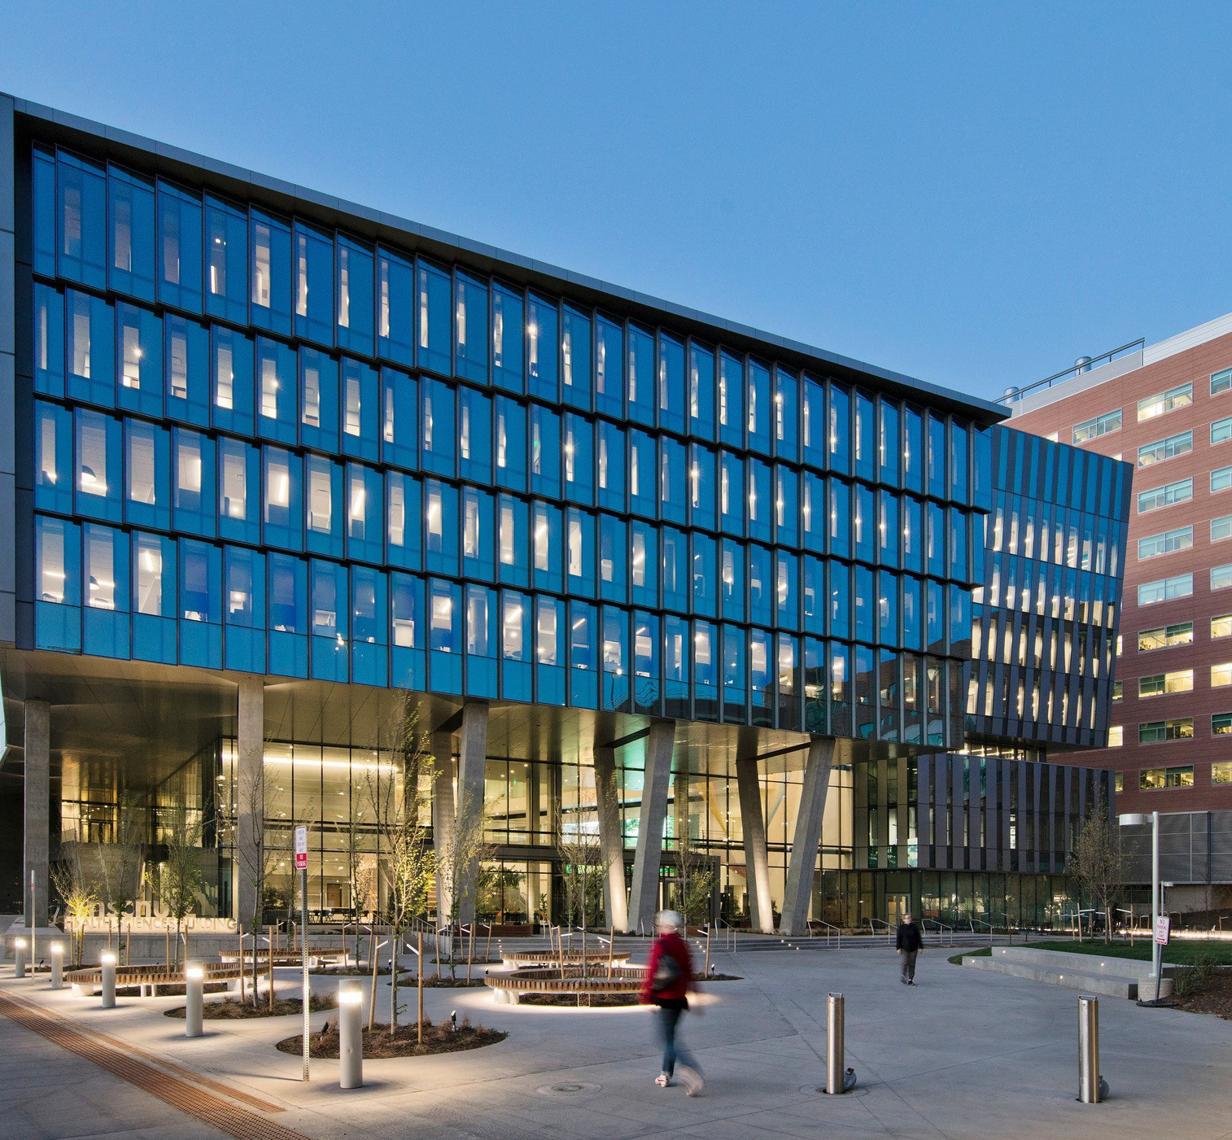




14th CU-CSU Summit
2026
“Advancing Neurosciences: From Molecules to Mind”
Ronald J. Sokol, MD Director and MPI of CCTSI
cctsi.cuanschutz.edu

Slide 2
CCTSI is part of the national CTSA Consortium
Clinical and Translational Science Award (NIH/NCATS)
An NIH-funded national consortium of biomedical research institutions collaborating to transform how clinical and translational science is conducted nationwide
Currently, ~60 funded Hubs, many of which include multiple universities and hospitals.
Grants originate from NCATS at NIH

Slide 3
Colorado Clinical &Translational Sciences Institute
CCTSI is the Colorado CTSA Hub
Created in 2008, refunded by NIH in 2013, 2018, 2023-2030
Substantial institutional support (funding)
Supports all faculty, post-docs, trainees involved in clinical or translational research at 4 university campuses and 5 hospital partners
“Disease – agnostic”
Infrastructure, research facilities, community engagement, education and training, resources & services, pilot grant funding, biostatistics & informatics, PEET, and much more…..

Slide 4
CCTSI Partners
University of Colorado Hospital
Colorado State University
Children’s Hospital Colorado
University of Colorado Anschutz
Rocky Mountain Veterans Affairs Medical Center
University of Colorado Boulder
Denver Health
University of Colorado Denver
NJH
Chancellor
School of Public Health
School of Dental Medicine
School of Medicine
College of Nursing
School of Pharmacy
Graduate School

Slide 5

CCTSI Vision
Accelerate and catalyze the translation of innovative science into improved, equitable health and patient care for all
Notes:
Updates to newest Vision

Slide 6
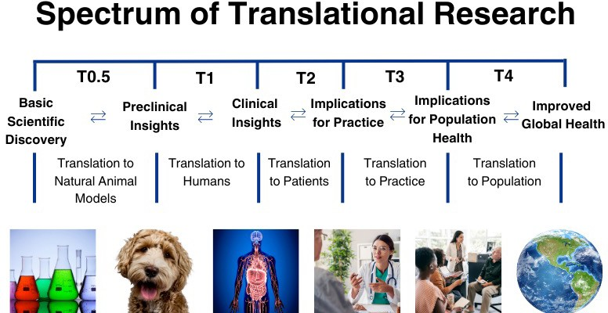

Slide 7


CCTSI 4.0 Mission
Breakdown barriers and accelerate translational science
Work collaboratively with OCT, VCR, ACCORDS, CHCO, UCH, etc.
Catalyze
Educate
Research
Communities
Catalyze and enhance scientific discovery, innovation, dissemination
Educate and sustain a resilient, innovative and broad translational
Promote and ensure an efficient, safe, collaborative and integrated research
Engage stakeholders and communities across the entire translational research
and translation across the lifespan.
Environment.
spectrum and state of Colorado.
science workforce.

Slide 8
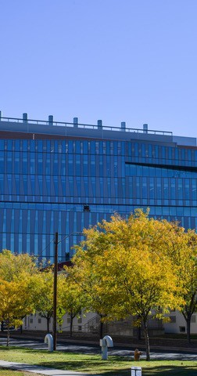

CCTSI Programs & Resources
Education, Training and Career Development – K12, T32 x 2, CLSC, etc.
Clinical Research Resources & Facilities – CTRCs x4
Community Engagement & Health Equity – Immersion training, Bootcamp Translation, Pilot grants, Iheard, CEAL
Dissemination & Implementation Research – tools, education, and consults
Team Science – Teaming and Leading Workshop Series
Biostatistics, Epidemiology and Research Design (BERD) – CIDA – Tools, education, study and grant design, statistician assistance
Translational Informatics – REDCap, N3C, Colorado Profiles, AI workshops
Research Bioethics – Consult service
Regulatory Knowledge and Support – OnCore, Training, DSMB, IND assistance
Pilot Grant Programs – CO-Pilot, CU-CSU, CMH, CEHE, Translational Methods
Trial Innovation Network – uses CTSA network to facilitate multi-center trials
Innovation and Entrepreneurship – iCorp customer discovery training,
Early Life Exposures Program (ELEP) – resources for research in PN populations
Pragmatic EHR Embedded Clinical Trials (PEET)

Slide 9

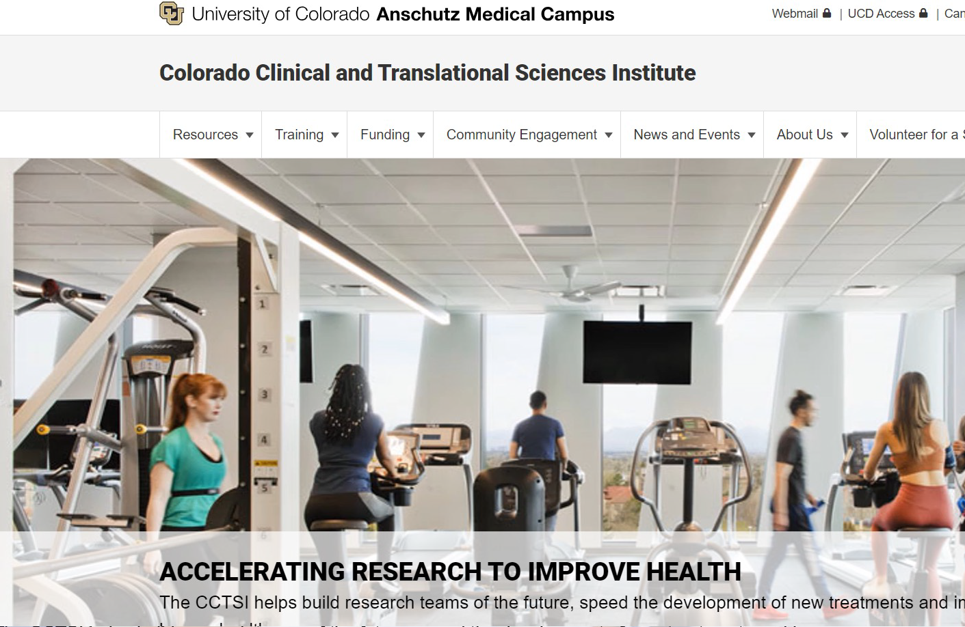
Website
cctsi.cuanschutz.edu
Become a Member!

Slide 10




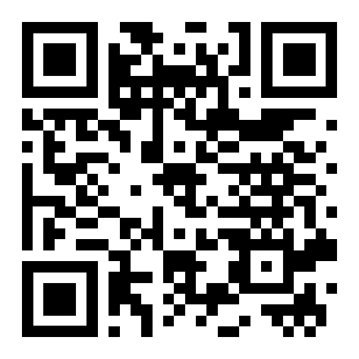
Contact Us
303 - 724 - 1222
cctsi.cuanschutz.edu

Slide 11

14th Annual CU-CSU CCTSI Summit
“Advancing Neurosciences: From Molecules to Mind”
Goals:
  Highlight ongoing research, resources and progress in Colorado
  Promote new collaborations, scientific exchange, mentor-mentee relationships, networking
In Person Format : 3 sessions, Lightning Talks, Poster Session, Breakfast and Lunch, Networking Time, Finish before 3:30 pm
https://cctsi.cuanschutz.edu

Slide 12
Thank You
CU-CSU Summit Planning Committee
Kevin Messacar, MD, PhD - CU Anschutz
Chris DeSouza, PhD - CU Boulder
Matthew Hickey, PhD - Colorado State University
Natalie Serkova, PhD - CU Anschutz
Janine Higgins, PhD - CU Anschutz
Wendy Meyer, MA - CU Anschutz

