Slide 1
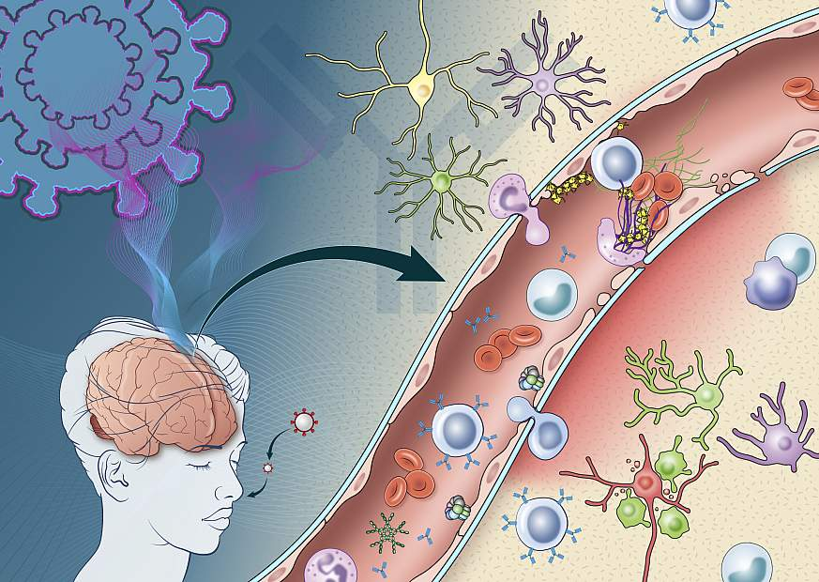
An Exploration of Neuro-Inflammatory Mechanisms in Long COVID: The role of SARS-CoV-2 Antigens
Matthew G. Frank, PhD
Department of Integrative Physiology
Department of Psychology & Neuroscience
University of Colorado Boulder
SARS-CoV-2 virus
National Institutes of Health

Slide 2
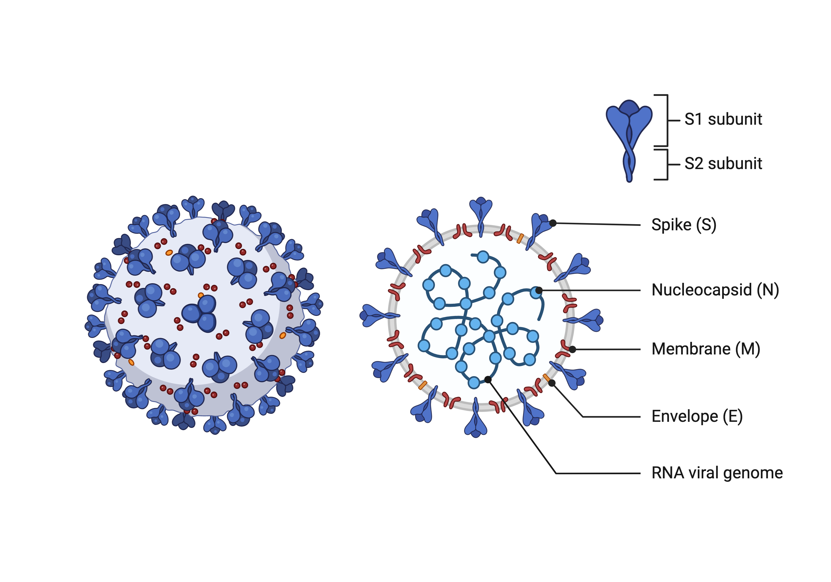
Severe Acute Respiratory Syndrome Coronavirus 2 (SARS-CoV-2) Structure
SARS-CoV-2 Properties
An enveloped, positive-sense, single stranded RNA virus.
Composed of several structural proteins (S, N, M, and E).
The S1 subunit of the S protein binds the angiotensin-converting enzyme (ACE)-2 receptor on host cells.
The S2 subunit mediates virus-host cell fusion and entry into host cells.
Frank et al., 2023. Brain Behav. Immun., 111, 259-269.

Slide 3
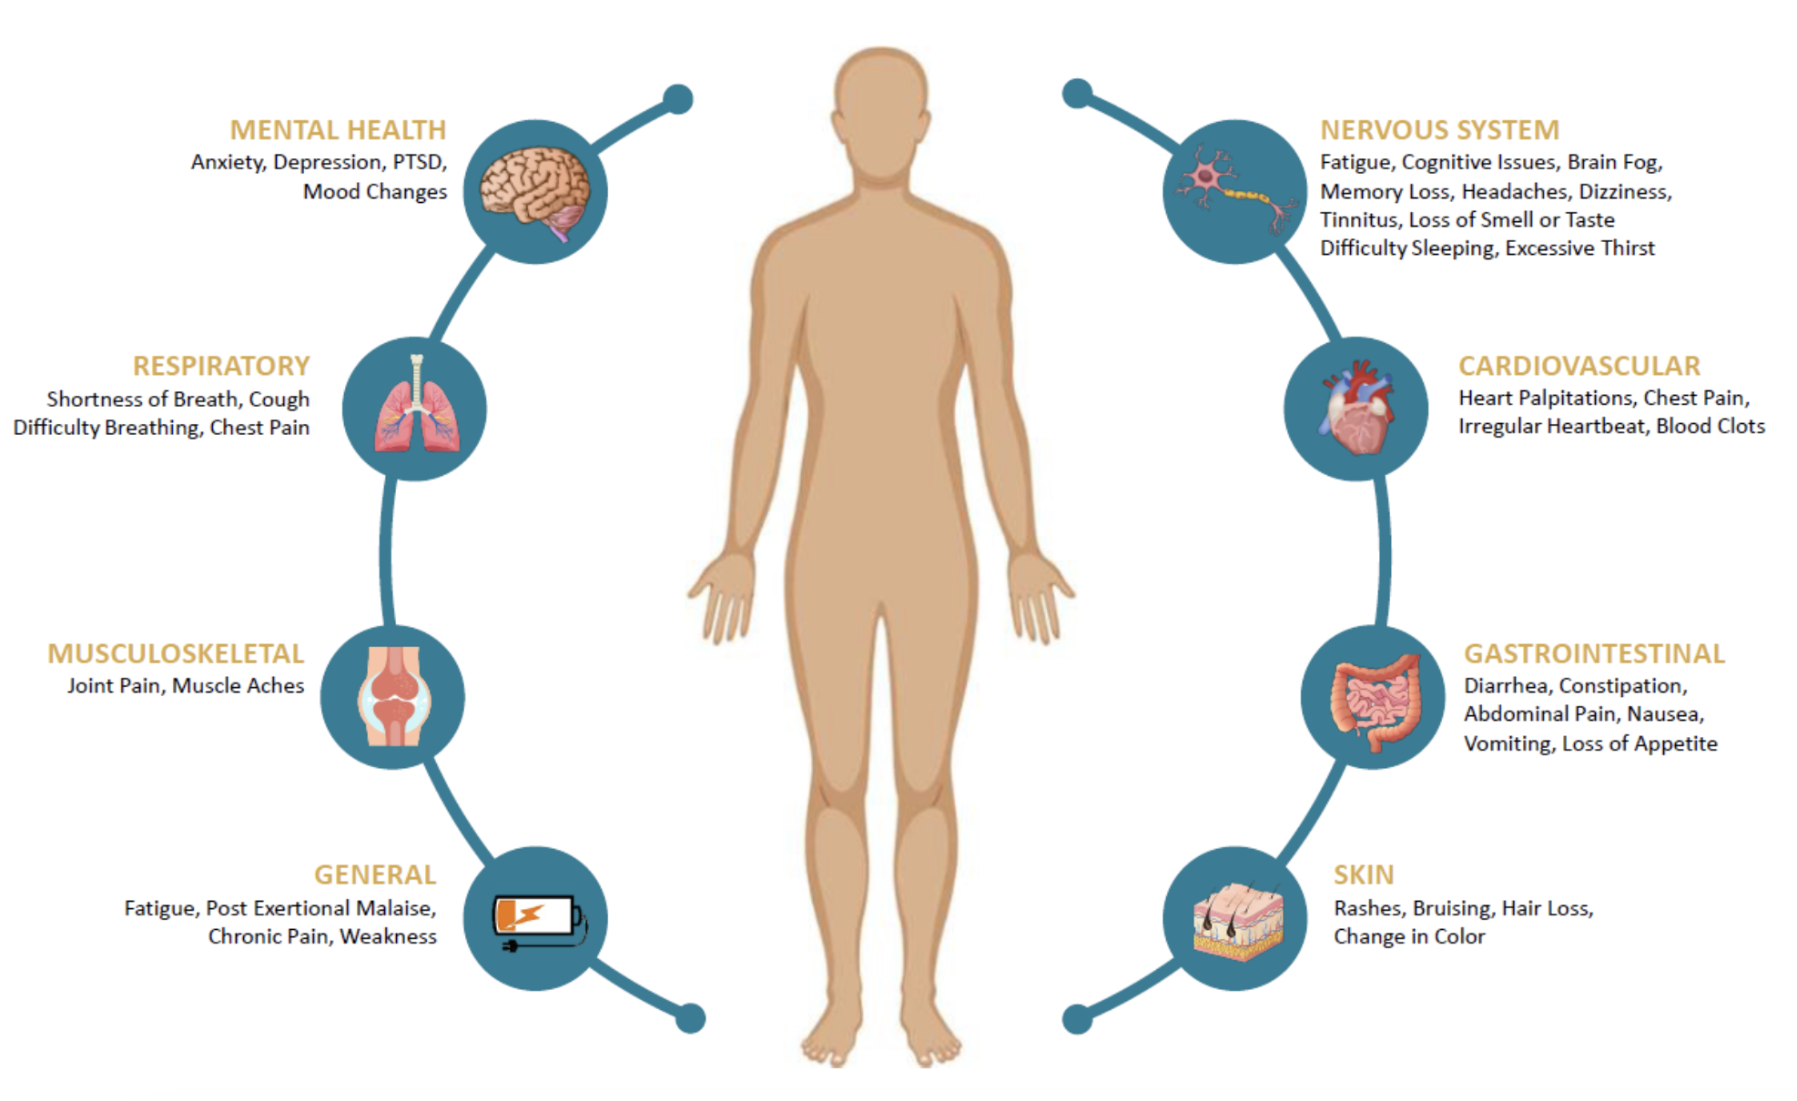
What is Long COVID or Post-Acute Sequelae of COVID-19 (PASC)?
A chronic relapsing/remitting condition that occurs after SARS-CoV-2 infection.
Symptoms can emerge, persist, resolve, and reemerge over weeks, months, or years after acute infection.
Symptoms involve multiple physiological systems.
Estimates of prevalence range from 10 – 30% of people who had COVID-19.
Graphic from Vanderbilt University

Slide 4
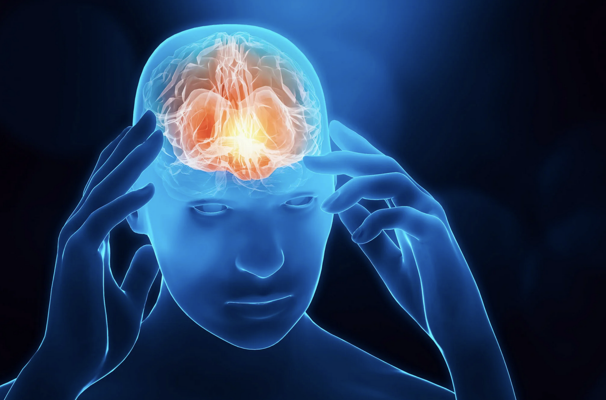
Neuroinflammation Can Drive Long COVID Symptoms
Fatigue
Post-exertional malaise
Brain fog
Sensorimotor symptoms
Headaches
Memory problems
Insomnia
The Harvard Gazette

Slide 5
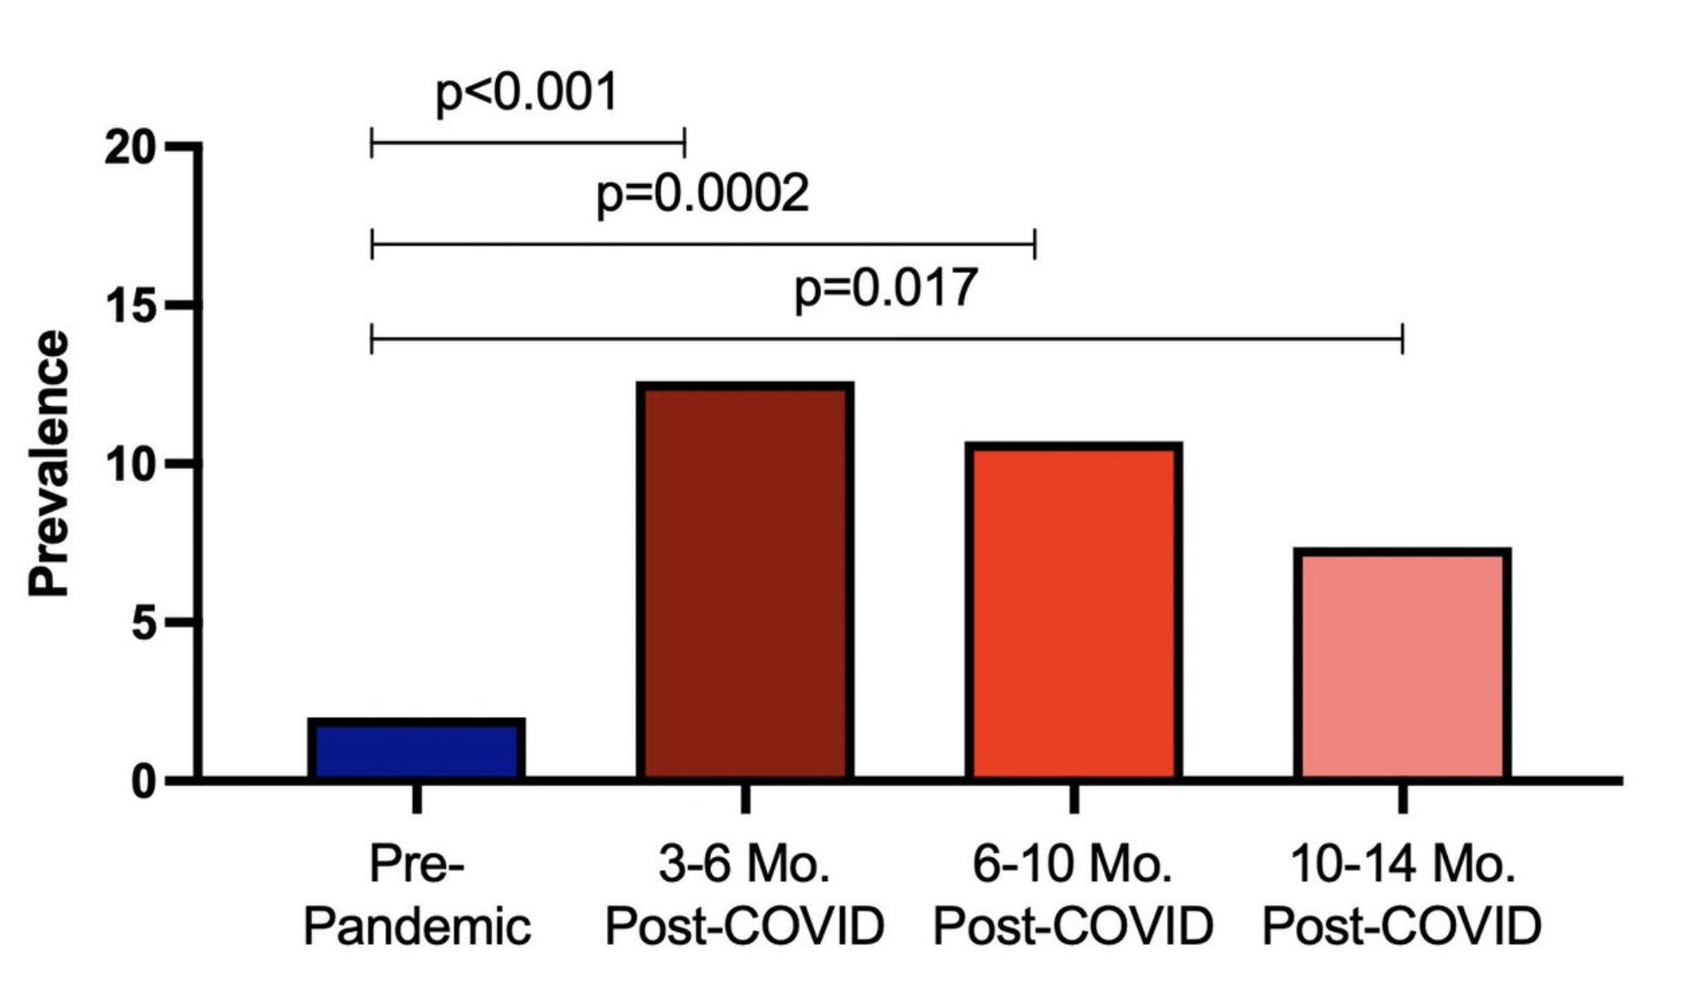
SARS-CoV-2 Antigens
Detection of SARS-CoV-2 Antigens in serum of Long COVID Patients
Detected in serum and leukocytes for months and years after infection.
Detected in post-mortem brain months after infection.
Multiple physiological systems show presence of antigens after resolution of COVID-19.
Antigens readily cross the blood brain barrier and gain access to immune cells (microglia) in the brain.
Peluso et al., 2024. Lancet Infect. Dis., 24, e345-e347.

Slide 6
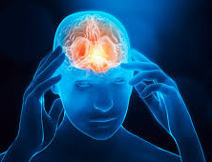

SARS-CoV-2 Viral Antigens Might Be Neuroinflammatory

Slide 7
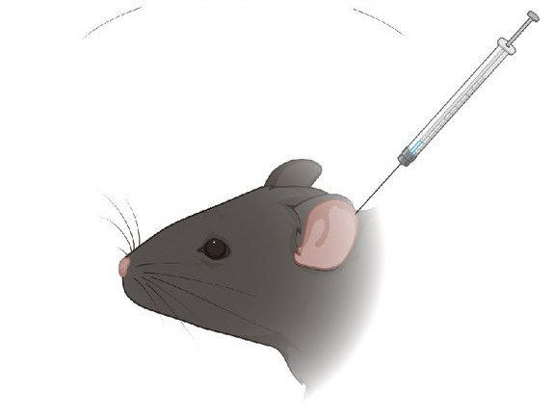

Effects of S1 Injected Into the Cerebrospinal Fluid
Neuroinflammation (cytokines)
Microglia Function
Sickness Behavior (activity, drinking, eating)
Endocrine Function (corticosterone)
Core Body Temperature
Cardiac Function
ICM injection
(S1 or vehicle)
24h, 1wk, 2wk

Slide 8

S1 Produces Durable Neuroinflammatory, Behavioral, and Physiological Effects
Neuroinflammation
Microglial/Neuroinflammatory Priming
Sickness
Reduced Anti-inflammatory Signaling (corticosterone)
Alters thermoregulation/cardiac function
Signals through pattern recognition receptors (TLRs)
Frank et al. (2022). SARS-CoV-2 spike S1 subunit induces neuroinflammatory, microglial and behavioral sickness responses: Evidence of PAMP-like properties. Brain Behav Immun, 100, 267-277.

Slide 9
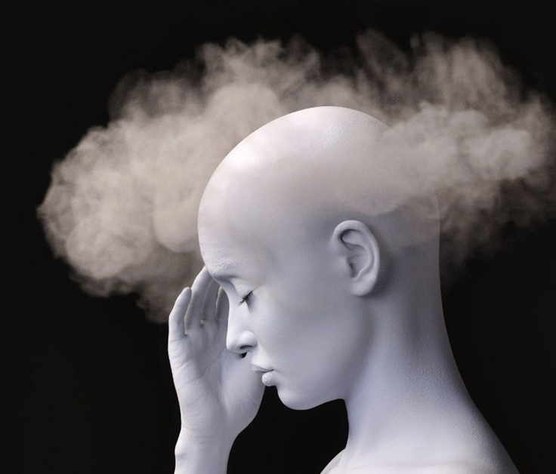
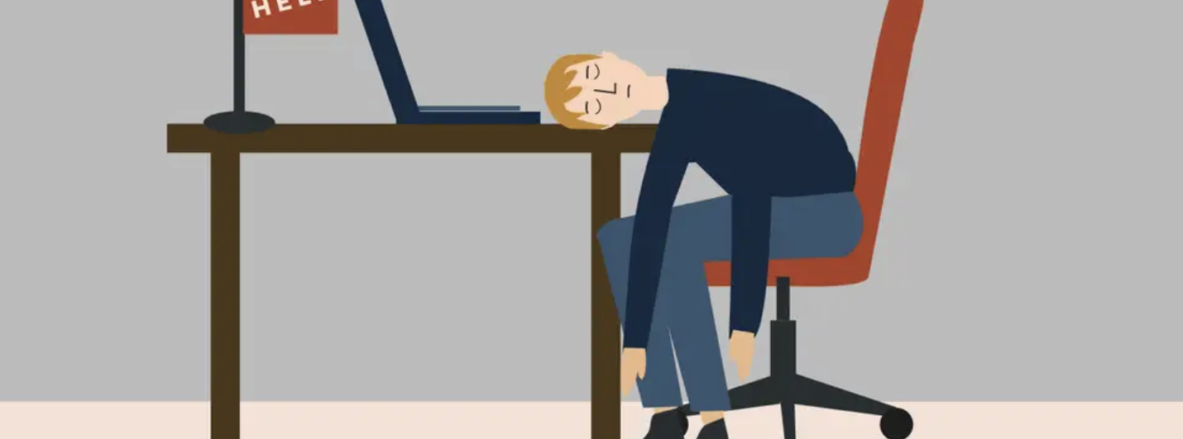
Conclusion:
SARS-CoV-2 antigens might play a key role in the etiology of neurological symptoms in Long COVID via modulation of inflammatory and endocrine processes in the brain.

Slide 10

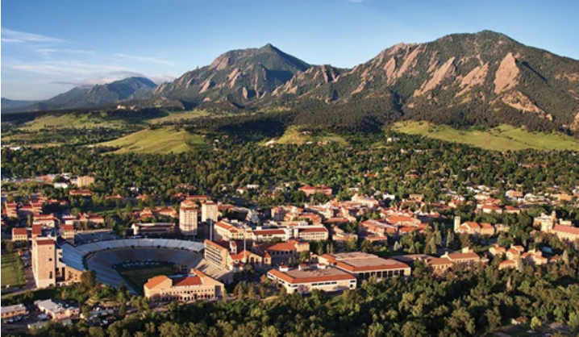
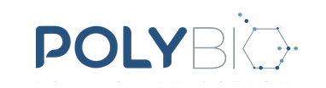
Acknowledgements
Department of Psychology and Neuroscience
Dr. Steven Maier Dr. Michael Baratta
Department of Integrative Physiology
Dr. Monika Fleshner Dr. Christopher Lowry
Dr. Robert Thompson
Shelby Hopkins
Tel Kelley
Angelina Kuzma
Kathy Nguyen (University of Iowa)
PolyBio Research Foundation
Michael VanElzakker and Amy Proal

