Slide 1
Clinic – Bench – Clinic
Integrating Clinical Care & Mechanistic Research for Chronic Mild Traumatic Brain Injury (mTBI)
Extending Discovery to Innovative Brain Health Protection & Optimization
Jeffrey R. Hebert, PhD, PT
Associate Professor, University of Colorado School of Medicine
Director of Research, Marcus Institute for Brain Health (MIBH)
Director, Physical Performance Laboratory - MIBH
Investigator, CU Center for COMBAT Research

Slide 2
Disclosures
I declare the following real or perceived conflicts of interest in the context of the subject of this presentation:
  Extramural research grants with salary support
    CDMRP, DoD Research Award: W81XWH-22-1-0566
    CDMRP, DoD Research Award: W81XWH-22-1-0954
    CDMRP, DoD Research Award: HT9425-25-1-0484
    Avalon Action Alliance Medical Research Award: 2201
  Intramural salary support
    Marcus Institute for Brain Health
  Science & Performance Advisory Board Member, International Concussion Society - Concussion.Org
AI (CoPilot; Adobe Firefly) was used to generate some of the slide designs, but not used for content development or delivery

Slide 3
Disclaimer
The following presentation is for overview of line of research and related data and directives and is not meant to be an exhaustive review or report on all research activity, and omissions are required to meet the purpose & time constraints of the current Summit talk

Slide 4
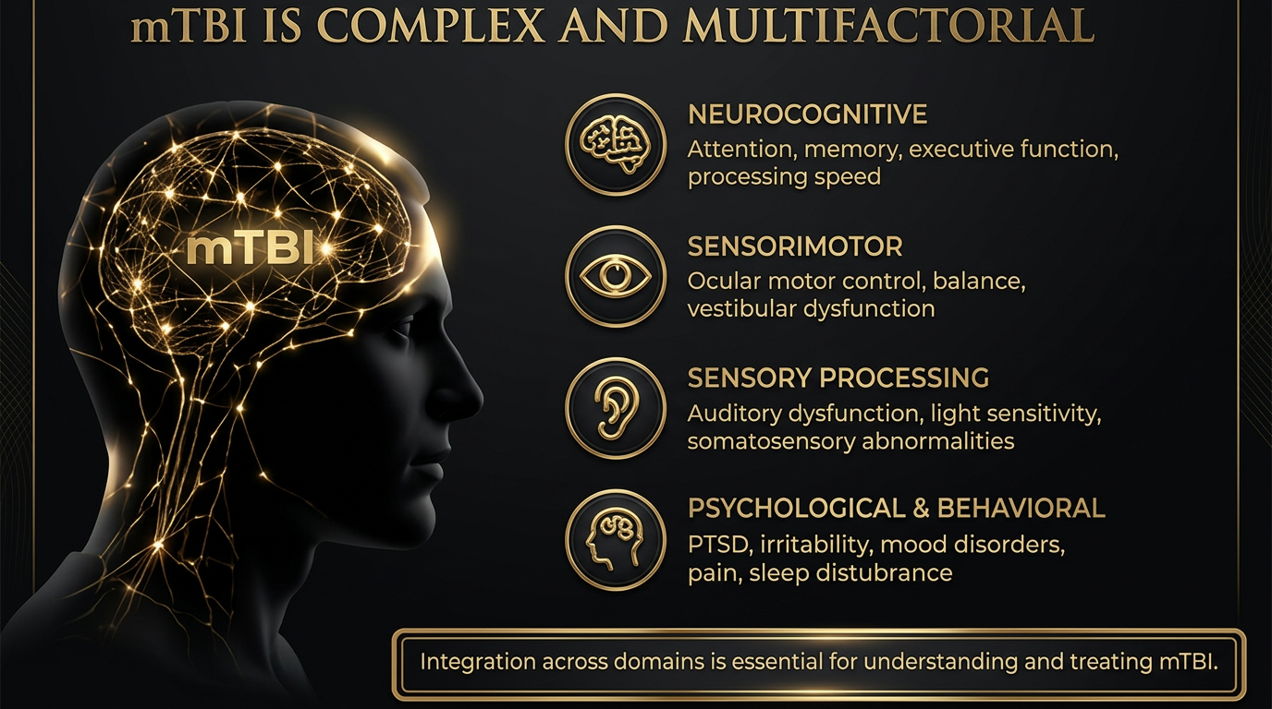


Slide 5
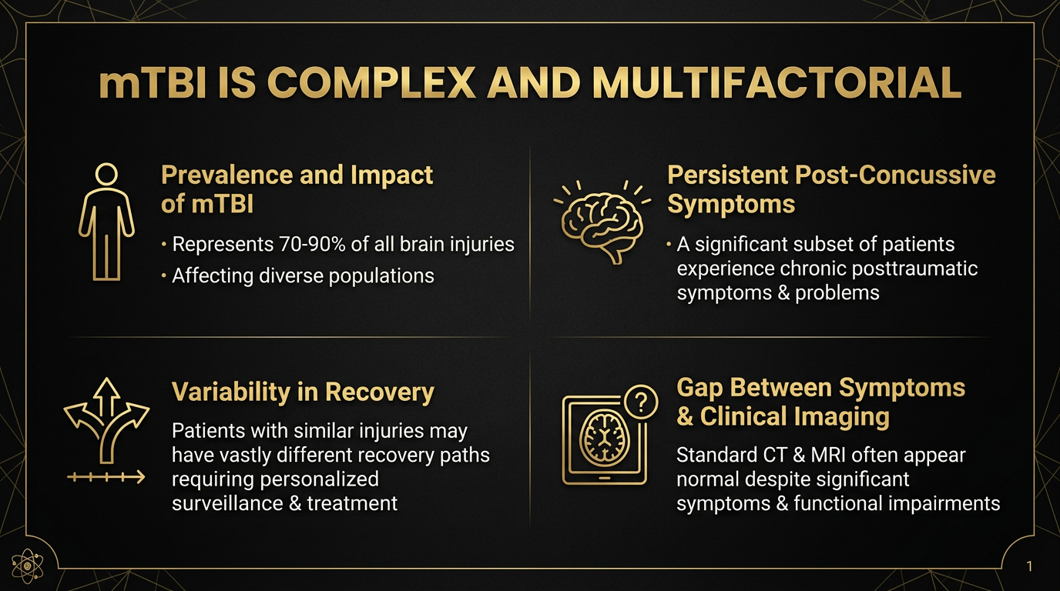

Slide 6
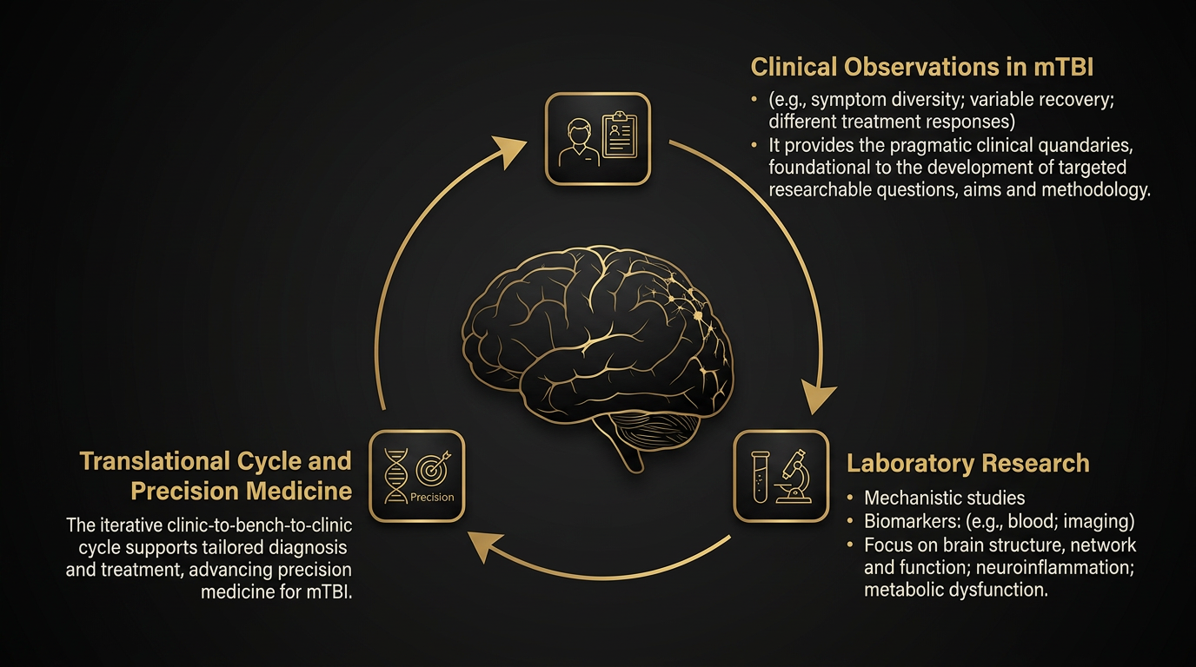

Slide 7
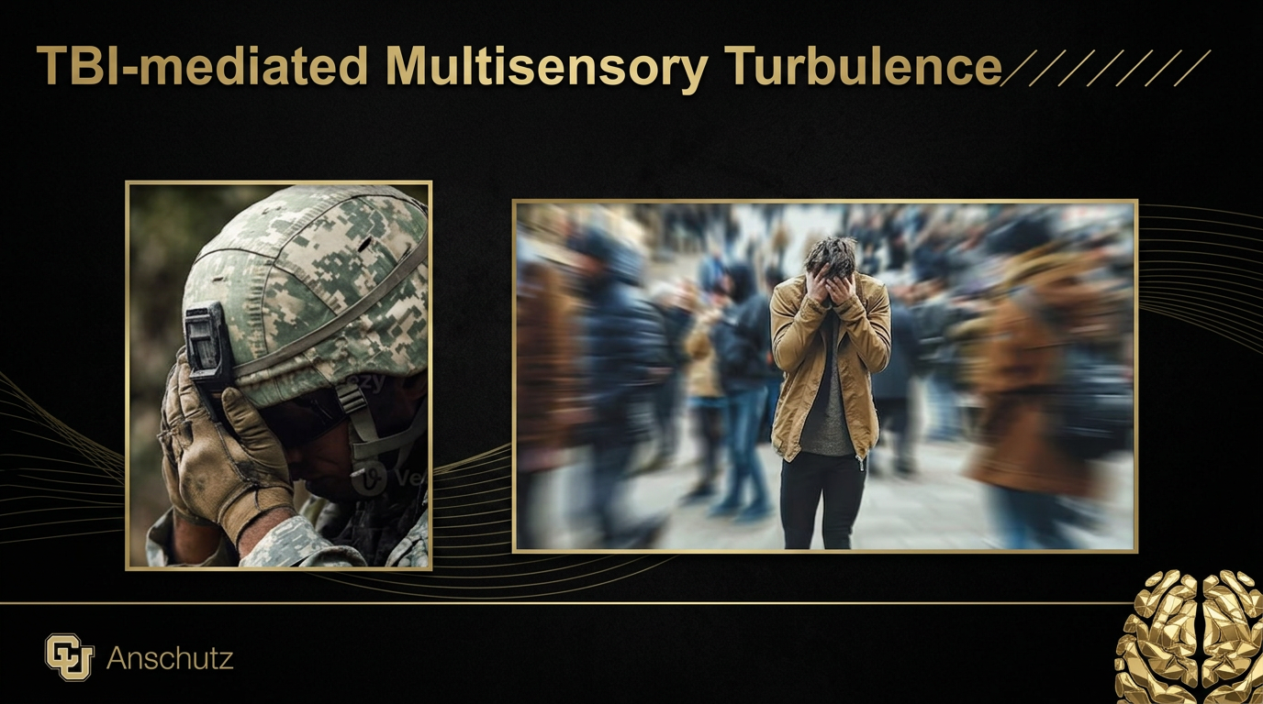

Slide 9
Two complementary MIBH CU Anschutz veteran mTBI studies
Parallel chronic mTBI veteran studies map clinical symptoms to measurable behavioral and neural systems
61 / 63*
2
10.6 y
Shared phenotype
Irritability study:
veterans with chronic mTBI / controls
Median lifetime mTBIs in the mTBI cohort
Mean time since most recent mTBI
• Military veterans with chronic mTBI
CDMRP DOW TBIPH Award:
W81XWH-22-1-0566
• Persistent multisensory function & management problems despite time separation since injury
38 / 40**
2
11 y
• Community-recruited samples, not seeking care & not symptom-selected
Oculomotor-cognition study: veterans with chronic mTBI / controls
Median lifetime mTBIs in the mTBI cohort
Median time since most recent mTBI
• MIBH CU Anschutz clinical platform
CDMRP DOW VRP Award:
W81XWH-22-1-0954
*Hebert JR, Ketchum JM, Filley CM, Crowder K, Rubinstein D, Karki R, Buard I, Schundler SA, McCann AV, Arciniegas DB. Irritability Among Veterans With Chronic Mild Traumatic Brain Injury: Psychological and Sensory Neurophysiological Factors. J Neuropsychiatry Clin Neurosci. Accepted 2026 July.
**Hebert JR, Wagner BD, Filley CM, Crowder K, Rubinstein D, McNamara S, Johnston-Brooks C, Karki R, McCann A, Subramanian PS. Ocular Motor Control and Cognitive Function in Military Veterans with Chronic Mild Traumatic Brain Injury. J Neuroophthalmol. 2026 Jun 1;46(2):219-228

Slide 10
Two complementary MIBH CU Anschutz veteran mTBI studies
Key findings: clinical measures
61 / 63
Group Differences
Adjusted Predictors of Irritability
Irritability: d = 1.21
PTS symptoms: d = 0.99
Average pain: d = 1.00
Functional hearing: d = 0.51
Postural control: d = 0.65
Probable PTSD: p < 0.001
Average pain: p = 0.008
Functional hearing: p = 0.034
Irritability study:
veterans with chronic mTBI / controls
• Military veterans with chronic mTBI
CDMRP DOW TBIPH Award:
W81XWH-22-1-0566
38 / 40
Group Differences
Adjusted Predictors of RNN
Rapid number naming (RNN): d = 0.91
Antisaccades (AS) - Latency, Error: d = 0.51 - 0.01
Verbal fluency (VF): d = -0.47
CPT-commissions – impulsivity (CPT-C): d = 1.06
VF: p < 0.001
Adjusted Predictors of AS (Latency)
Oculomotor-cognition study: veterans with chronic mTBI / controls
Overall models: p = 0.05 - 0.01
Adjusted Predictors of AS (Error)
CDMRP DOW VRP Award:
W81XWH-22-1-0954
VF: p = 0.10 - <0.01
CPT-C: p = 0.23 - <0.01
Age: p = 0.58 - <0.01
Proposed take home: the studies create a coherent clinic-to-bench narrative, with irritability and psychological-sensory neurophysiological burden on one side and an oculomotor-cognition axis on the other

Slide 11
Two complementary MIBH CU Anschutz veteran mTBI studies
Irritability study: Initial key MRI brain imaging findings
Relevant to today’s gray matter (GM) discussion, MR acquisition included:
CU Research Imaging Center
3D T1-weighted, T2-weighted, and fluid-attenuated T2-weighted structural / morphological sequence (e.g., volume, thickness)
neurite orientation dispersion and density imaging (NODDI) (e.g., neurite density index; CSF volume fraction; orientation dispersion index-ODI) for GM microstructure estimates
• Military veterans with chronic mTBI

Slide 12
Initial overall key findings:
Minimal to no group differences & no irritability associations for more standard clinical metrics (e.g., volume, cortical thickness)
Group differences and irritability associations for NODDI metrics
ODI highlights potential microstructural contributions to irritability

Slide 14
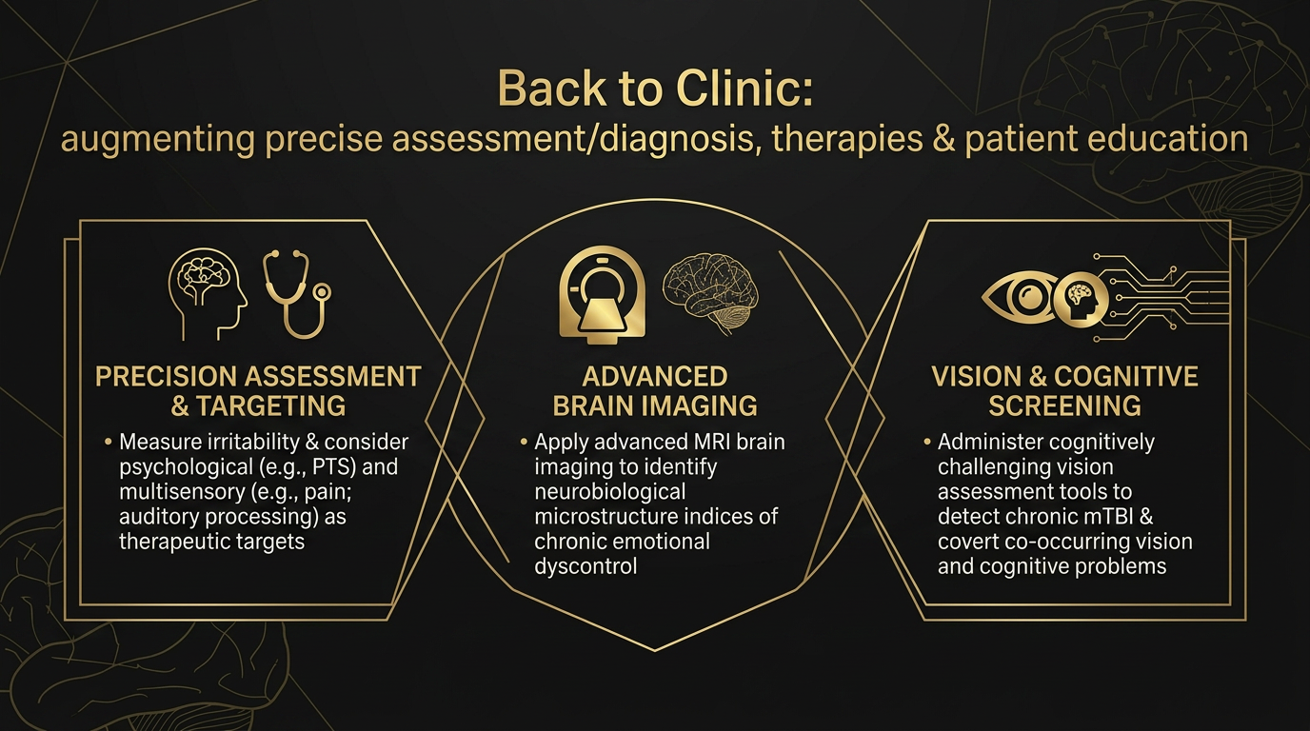

Slide 15


Acknowledgements
Thank you to the participants who volunteered their time & effort
Thank you to my research teams/personnel that made this work possible:
  Christopher M. Filley, MD, Jessica M. Ketchum, PhD, Kayla L. Crowder, DPT, David Rubinstein, MD, Ramesh Karki, MS, Isabelle Buard, PhD, Shaylin A. Schundler, MS, CCC-SLP, Ashley V. McCann, DPT, David B. Arciniegas, MD, Brandie D. Wagner, PhD, Stephen M. McNamara, OD, Catharine H. Johnston-Brooks, PhD, Prem S. Subramanian, MD, PhD
15

