Slide 1
Effects of Alcohol and Cannabis on Brain Function
Joshua Gowin, PhD
Department of Radiology
August 13, 2026
Notes:
BEST PRACTICES & ACCESSBILITY STANDARDS:
”Save as” this template before you begin and rename it to the title of your presentation. This way, you will retain a copy of this blank template for future use.
To edit the Master Slide go to View > Slide Master. Note: Please refrain from making significant edits to the Master Slides.
Choose a title slide theme and then delete the other options
To add a new slide go to Insert in the navigation bar > New Slide and click the drop-down arrow to choose from different slide layouts and designs.
For body text keep font size at 18pts or larger. For headers keep font size at 24pts or larger.
For any new image or icon you add please add a description in the alt text. Right click image > click on View Alt Text > type in image description

Slide 2
Disclosures
None

Slide 3
Acknowledgements
Data were provided by the Human Connectome Project, WU-Minn Consortium (Principal Investigators: David Van Essen and Kamil Ugurbil; 1U54MH091657).
NIAAA R01: R01AA031244
CCTSI: Co Pilot CO J 21 69
Jarrod Ellingson PhD, Hollis Karoly PhD, Peter Manza PhD, Megan Ross PhD, Matthew Sloan MD, Jody Tanabe MD, Nora Volkow MD, Christian Hopfer MD, Joseph Schacht PhD, Anne Penner PhD, Tirzah Wethern MD, Landon Tomb MS, Colleen Sheller BS, Ellie Decker Ramirez, PhD, Stacey Blankenship, BS

Slide 4
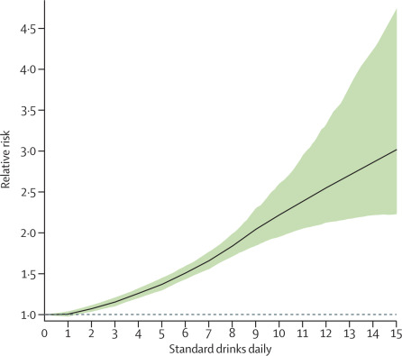
Heavy drinking increases morbidity and mortality
Griswold et al, Lancet, 2018

Slide 5
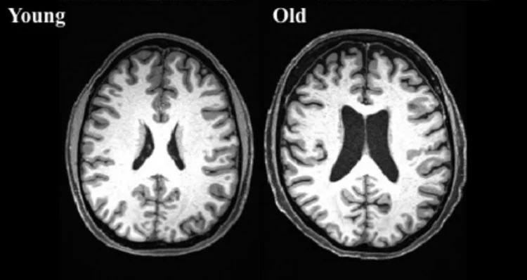
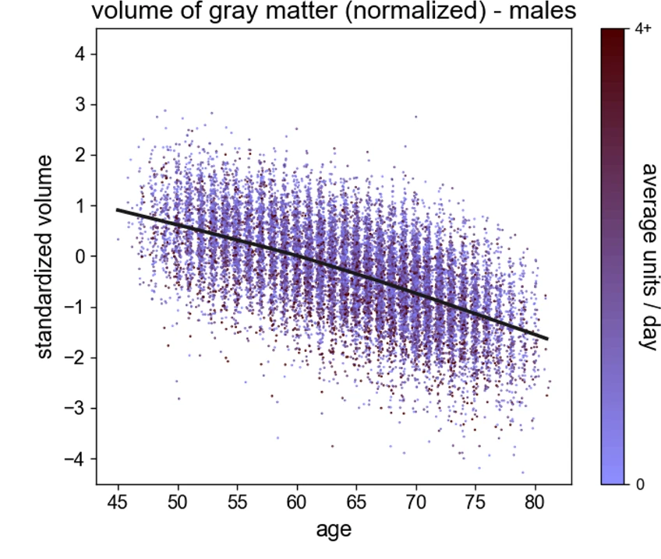
Brain Volume Declines With Age
Daviet et al., (2022) Nat Comms

Slide 6
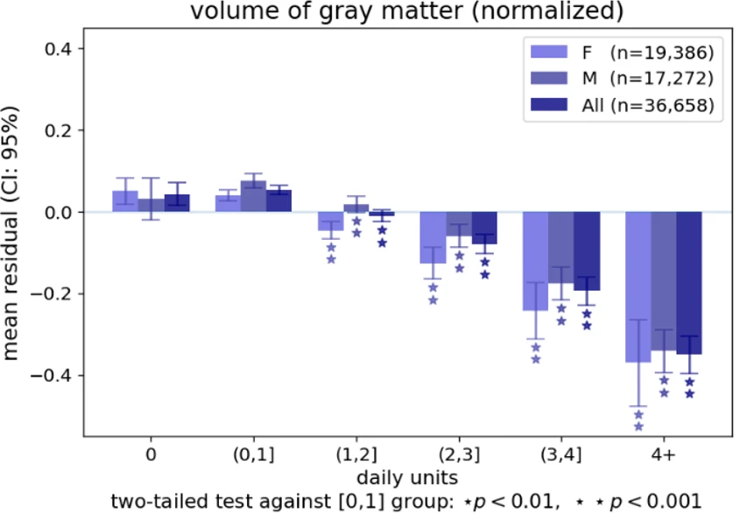
Alcohol Use Accelerates Decline
Daviet et al., (2022) Nat Comms

Slide 7
Can we identify risky drinkers using brain and behavioral markers?

Slide 8
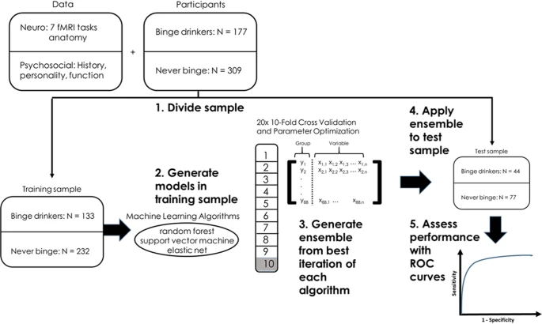
Gowin, Manza, Ramchandani, Volkow, Mol Psychiatry, 2021

Slide 9
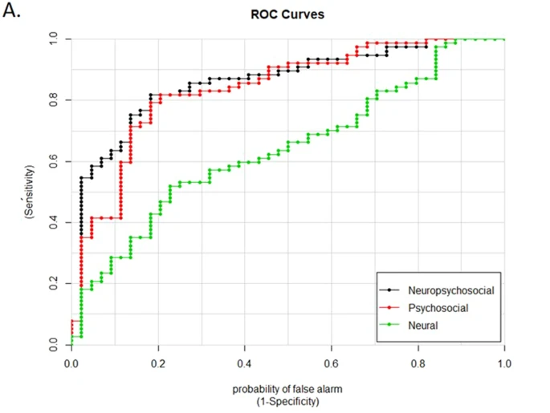
Aggregate models performed well in the test set
Gowin, Manza, Ramchandani, Volkow, Mol Psychiatry, 2021

Slide 10
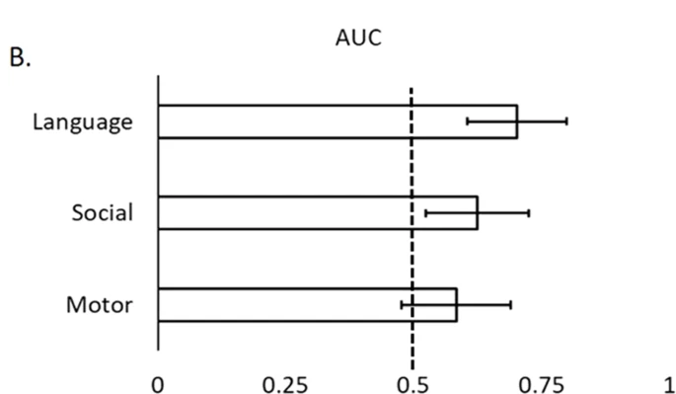
3 tasks were significant in training, only 2 in test

Slide 11
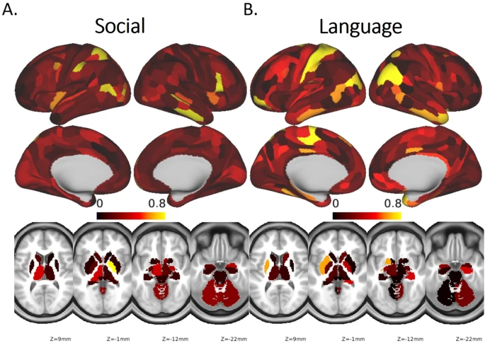
Weights from machine learning

Slide 12
We can identify aspects of alcohol use
Does it recover?

Slide 13
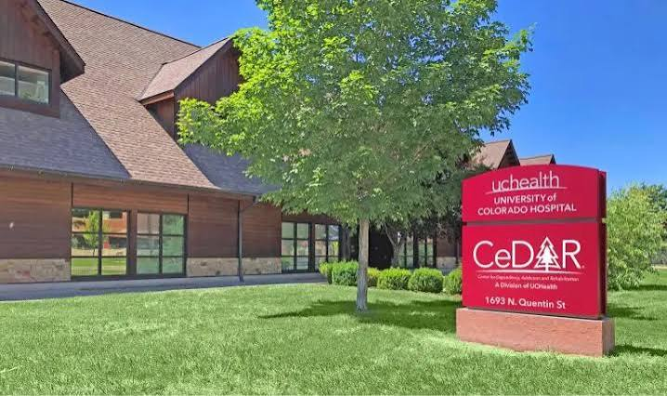
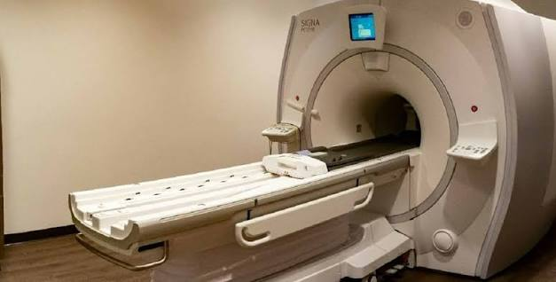

Slide 14
Self reported urge to consume alcohol
Notes:
N sample sizes: HC= 11 AUD1=42 (removed 3; 1 button box did not record) AUD2= (removed 2)
Session data was removed when subjects answered <30% of the time
All other subjects had at least half of the responses complete for each stimuli block type

Slide 15
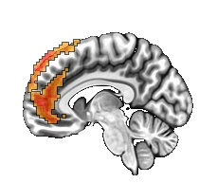
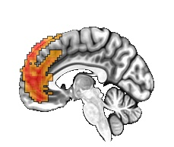
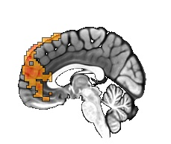
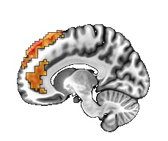
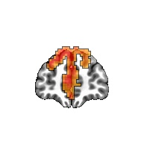
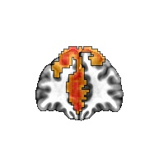
Brain regions responsive to alcohol
z:-12
z:-7
z:3
z:-5
x:52
x:45
Notes:
P-bar-0-30

Slide 16
Preliminary evidence of change during treatment

Slide 17
Some evidence of recovery, 1/3 of sample collected

Slide 18
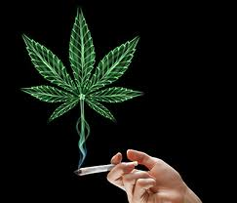
Changes in legal status, changes in perception

Slide 19
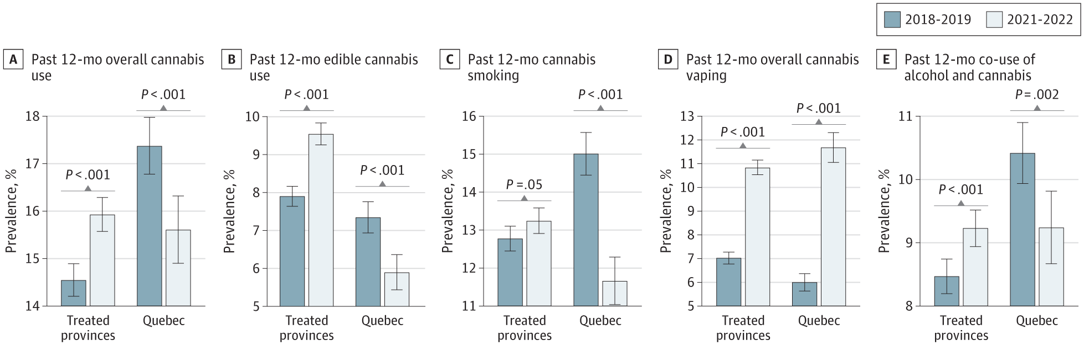
Legalization has changed use patterns
Mital, JAMA Network, 2025

Slide 20
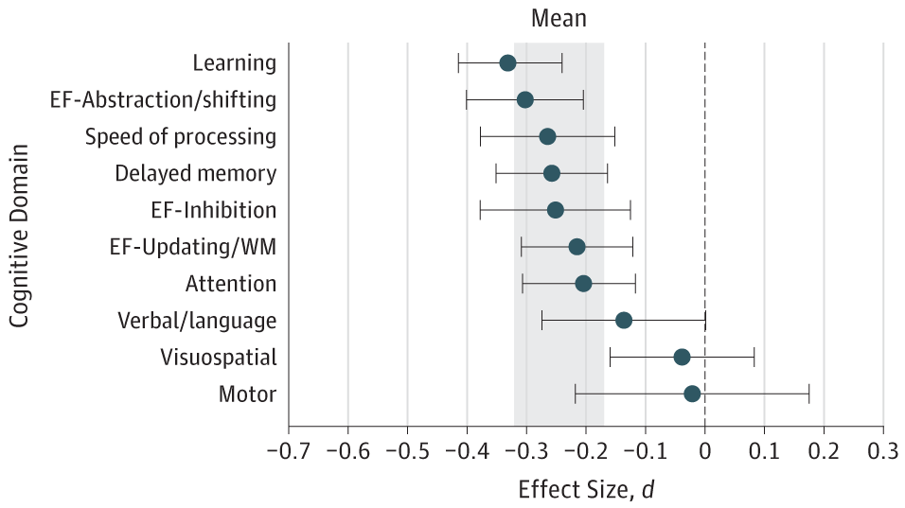
Cannabis has small, consistent effects on cognition
Scott, JAMA Psych, 2018

Slide 21
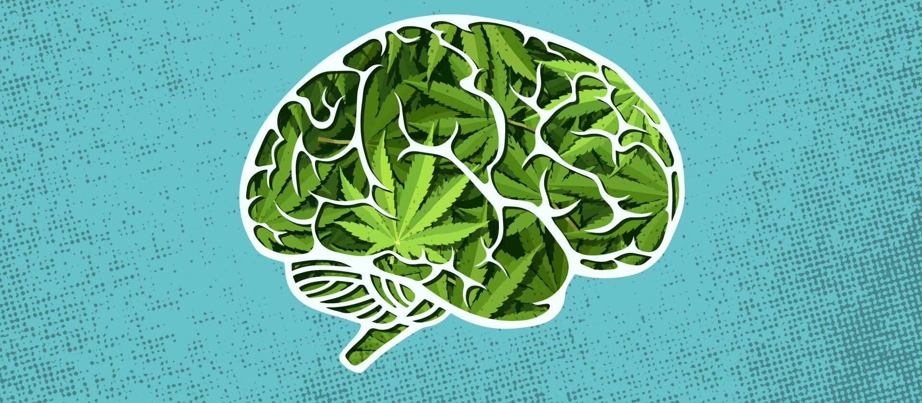
Brain function
Limited evidence, mostly in small samples
Difficult to compare across domains

Slide 22
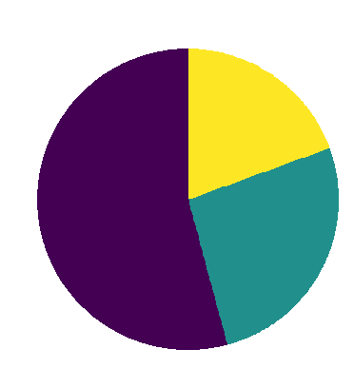
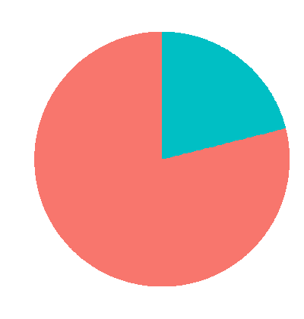
1,005 participants
Heavy User
Moderate User
THC +

Slide 23
What effect does cannabis have on brain function?

Slide 24
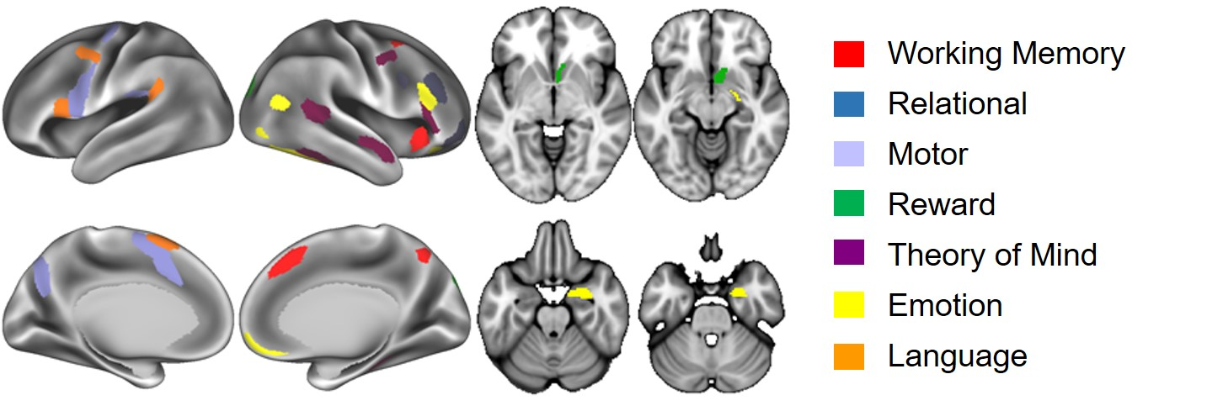
For each task, we averaged across the key regions (for parsimony and completeness)
Gowin et al., JAMA Network Open, 2024

Slide 25
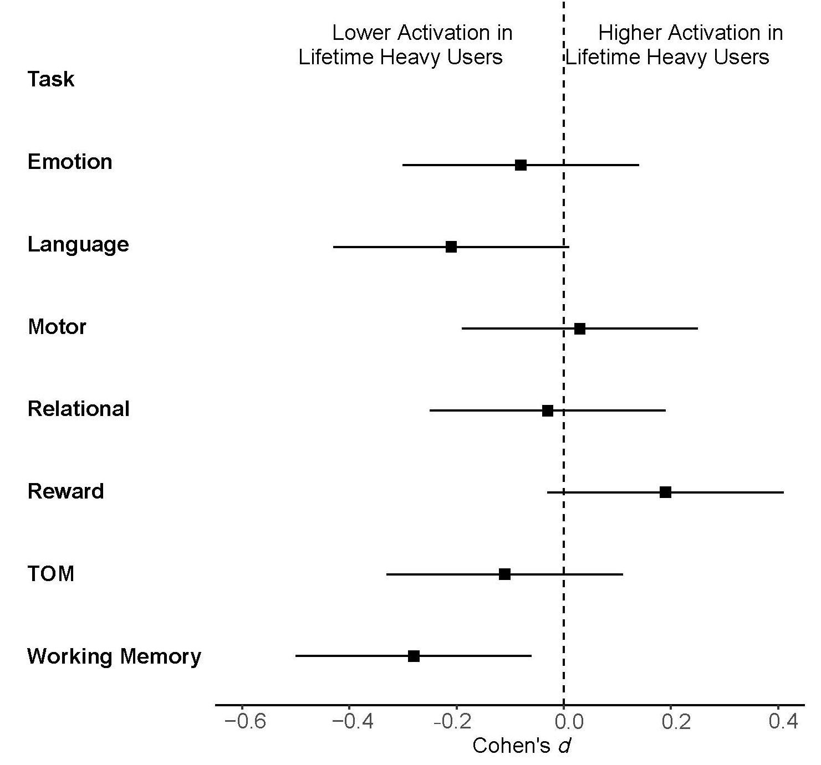
Heavy user (N=88) vs Non-User (N = 736) Lower activation during working memory
Gowin et al., JAMA Network Open, 2024

Slide 26
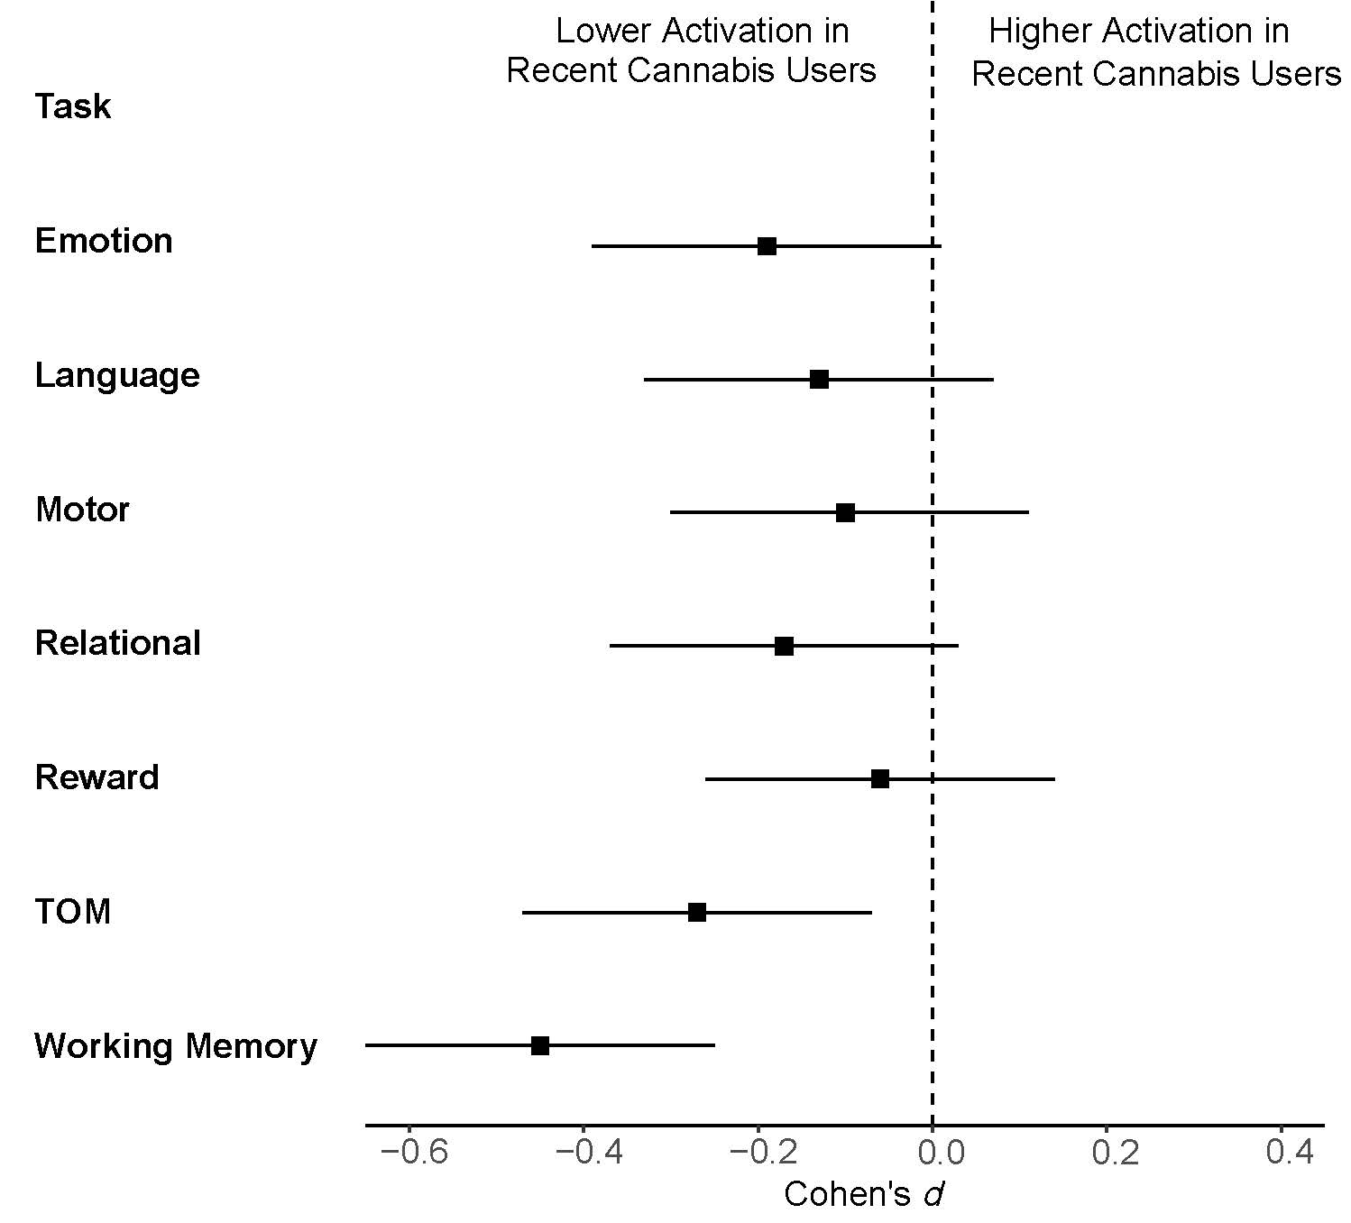
Recent THC (N=106): lower activation in general, including during working memory
Gowin et al., JAMA Network Open, 2024

Slide 27
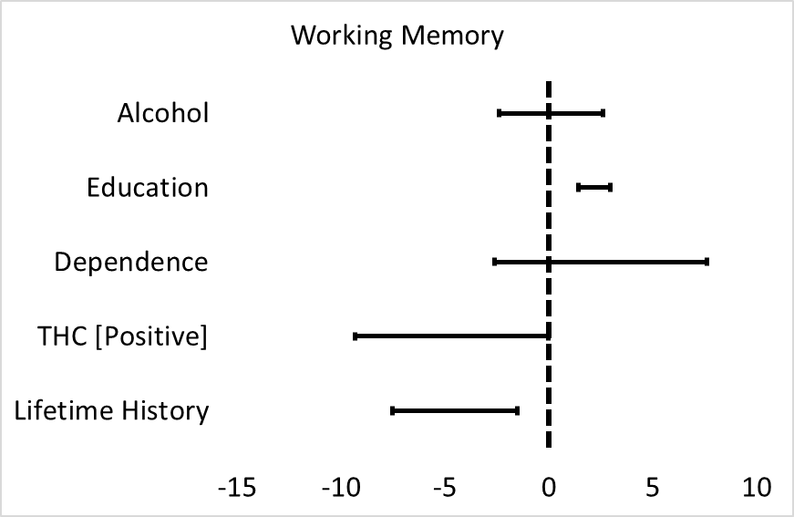
Full model, adjusting for multiple comparisons, shows only lifetime use is significant

Slide 28
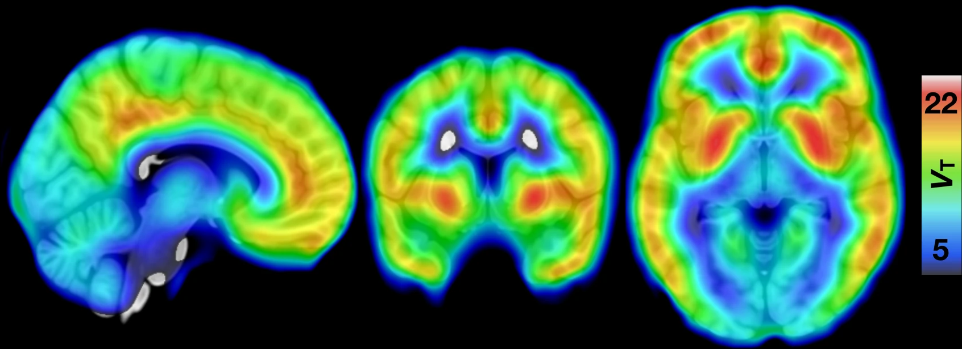
Location of cannabinoid receptors in brain

Slide 29
Conclusion
Alcohol and cannabis use may have differential effects on the brain
Alcohol reduces volume, accelerates aging
May recover
Cannabis may disrupt memory activation

Slide 31
Is the lifetime effect simply due to people who are still actively using (tested positive)?
38 individuals had heavy lifetime use, negative urine test
Effects remain when removing individuals with recent use

Slide 32
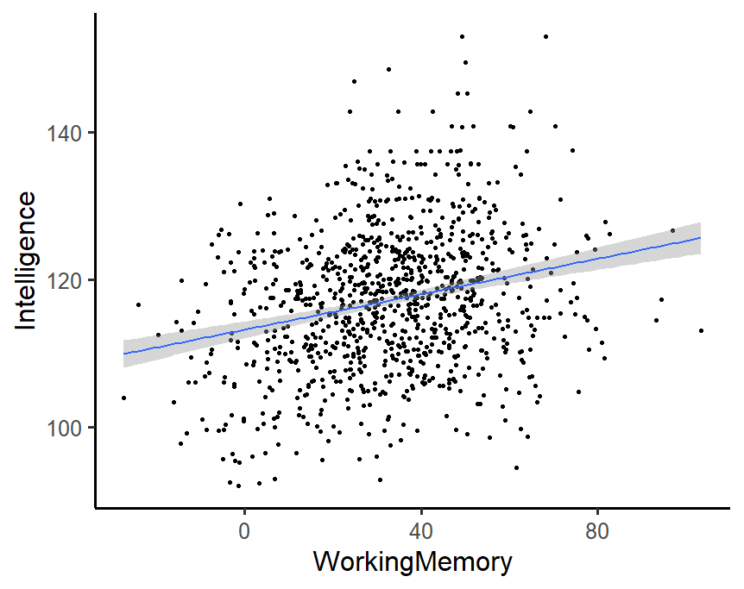
Is brain activation meaningful? Evidence suggests yes
r = 0.24, p < 0.001

Slide 33
We identified regions strongly associated with each task
Glasser et al., Nature, 2016

Slide 34
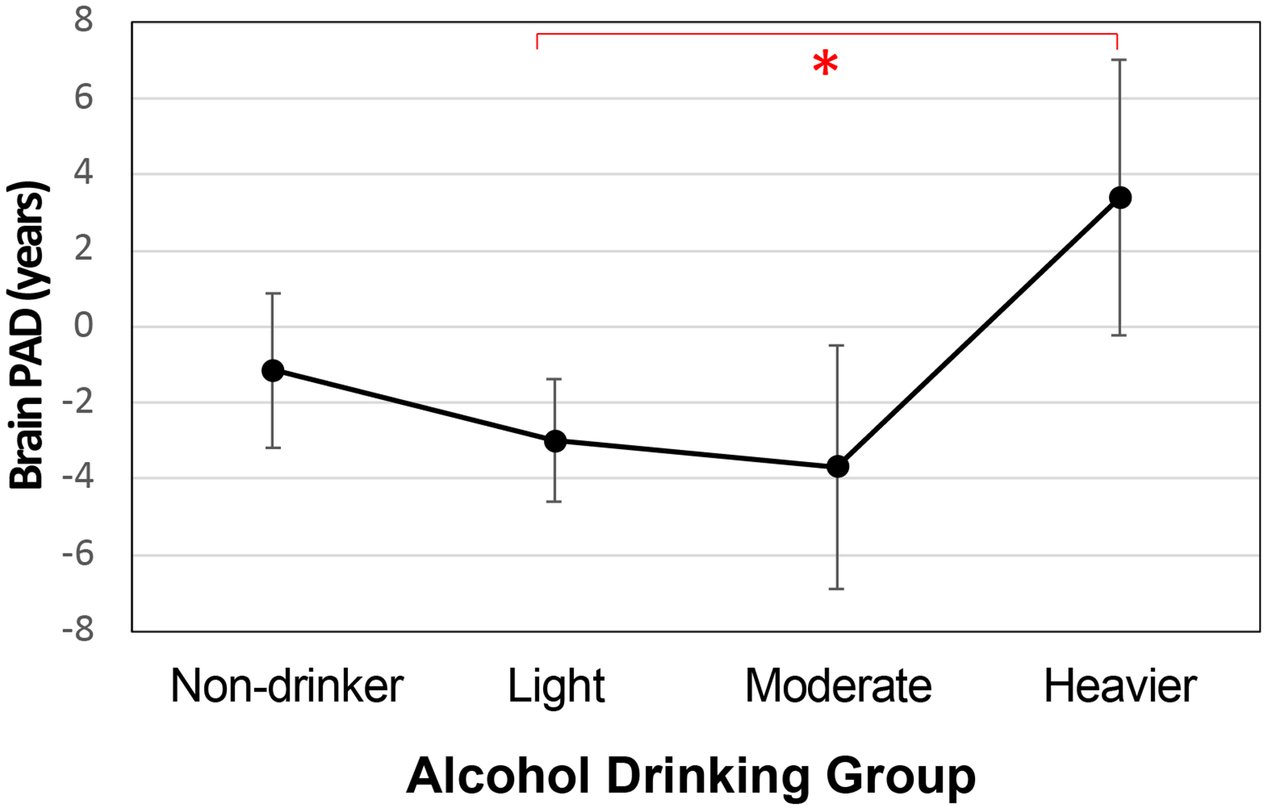
Brain Age and Alcohol
Funk-White et al. (2024) Am J Geriatr Psychiaty

Slide 35
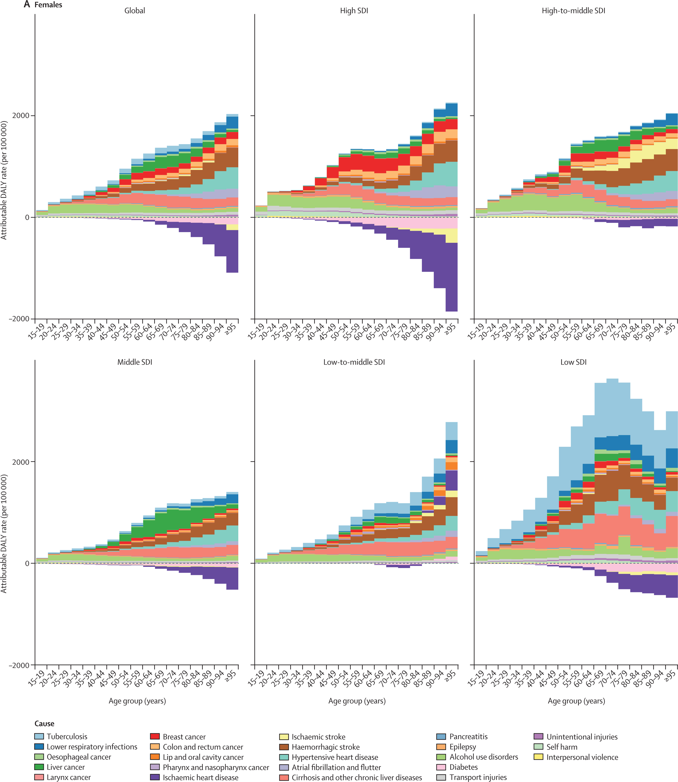
Griswold et al, Lancet, 2018

