Slide 1
Epic Use Plan Guide
March 14, 2023

Slide 2

EUP Guide on CCTSI website
Locations
https://cctsi.cuanschutz.edu/resources/ctrc/locations#ac-childrens-hospital-colorado-1
Services
https://cctsi.cuanschutz.edu/resources/ctrc/services/chcoservices

Slide 3
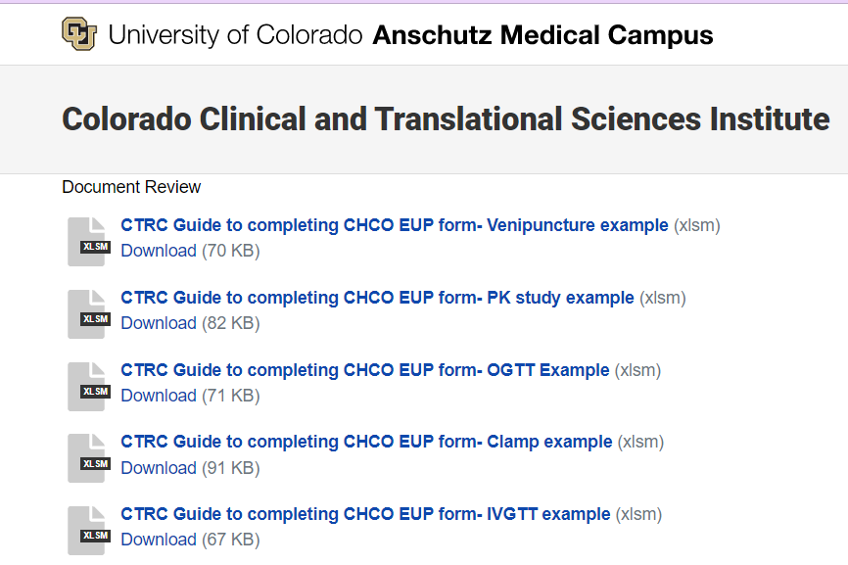

Slide 4
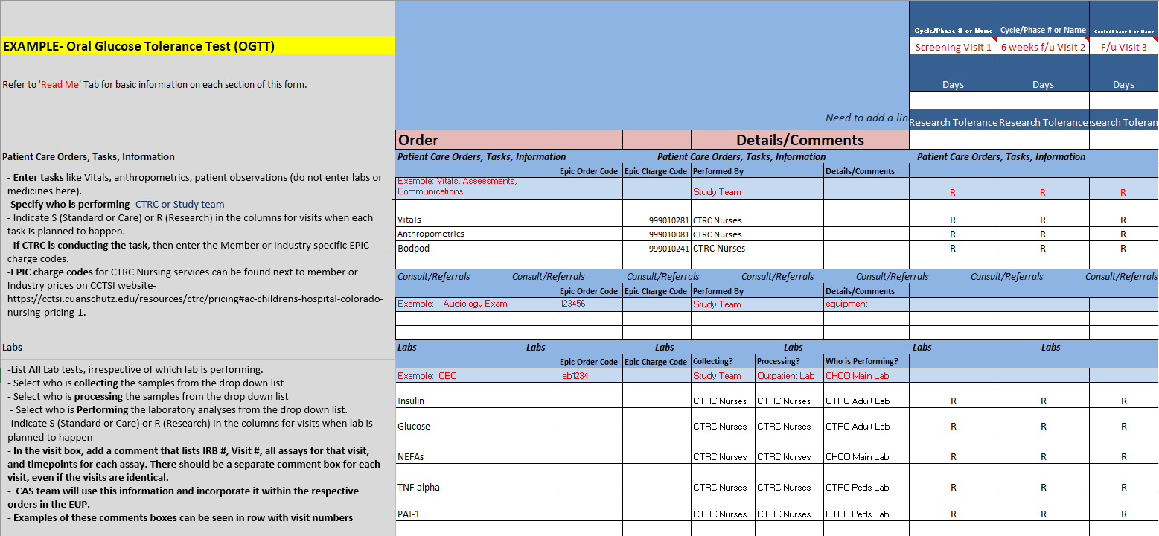
Step-by-Step guide
Completed examples of common procedures

Slide 5
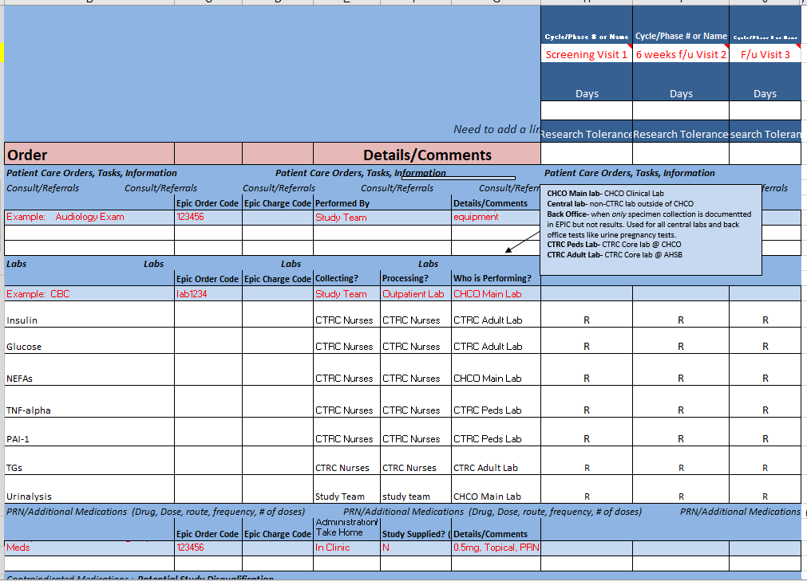
Visits
Completed lab section- various lab locations and what they mean

Slide 6
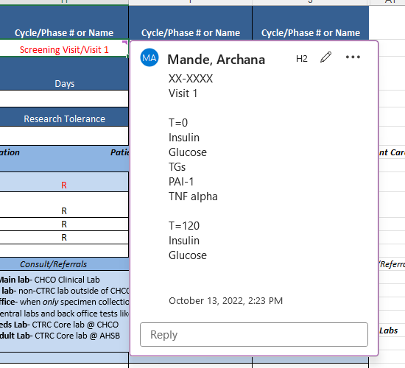
Comment box with timepoints

